Slide 1
Unit:3

Slide 5
Read the consumer complaints. Find one sentence in each picture that is a complaint and underline it.

Slide 6
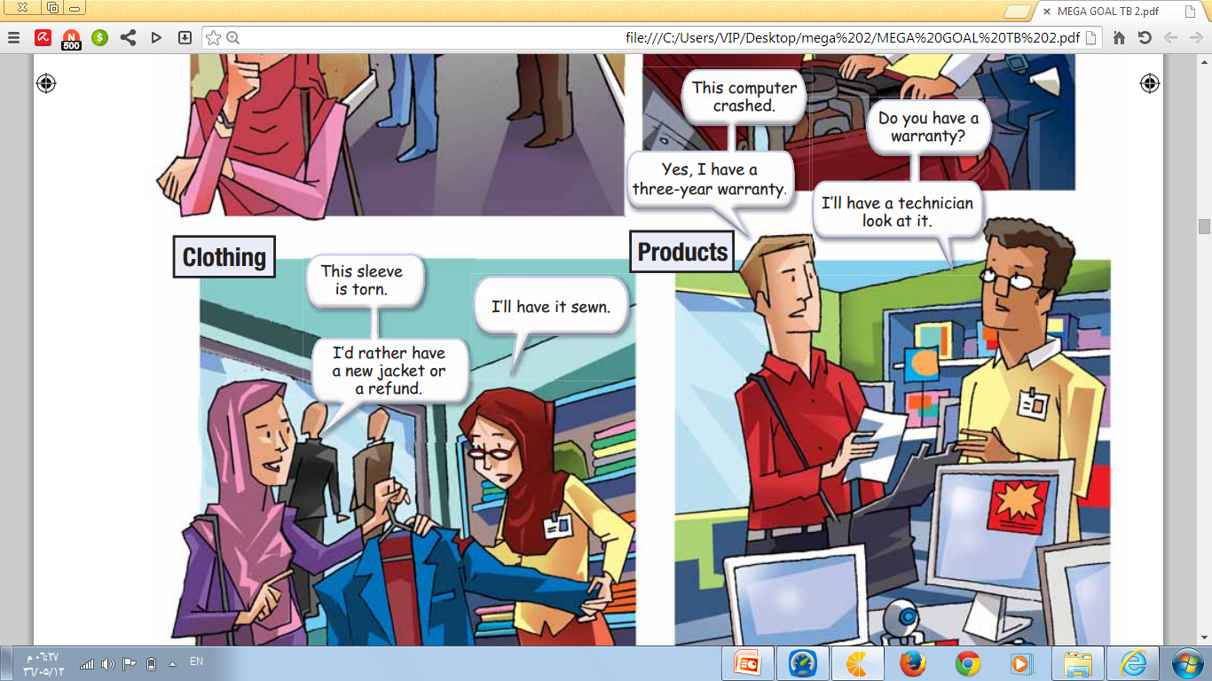

Slide 7
the four categories of consumer problems

Slide 12
Prepared by:
Tr. Sara Alshaheri

