Slide 1
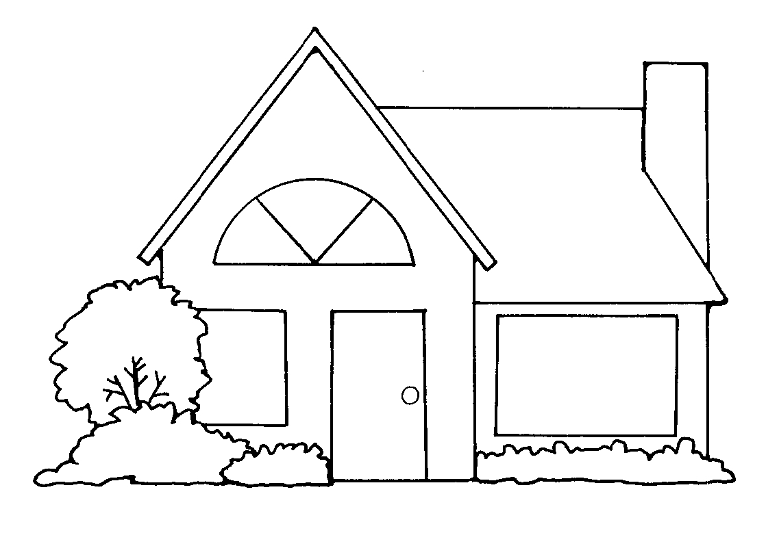
Second Grade Test (1)
A-Vocabulary
1-Complete the sentences with the correct words:
1- The museum has a quiet and peaceful ……………………………
2-We used the tree for ………………………….during the storm.
3-When children have nightmares, mothers give ………………………..with loving words.
4-Having great ………………………..means nothing if you can’t share it with others.
wealth
atmosphere
loyalty
shelter
comfort
2-Match correctly:
B | A
a- the opposite of increase. b- very small. c-sadness. d-old & used. e-take care of, keep in good condition. f-afraid of small & closed places. g-faithfulness & devotion. h-put beds, tables & sofas in a house. | 1-( )furnish 2-( )claustrophobic 3-( ) maintain 4-( )decrease 5-( )tiny 6-( )sorrow 7-( )loyalty 8-( )worn
3-What is an advantage f tiny houses?
……………………………………………………………………………………………………………………..
B-Grammar
1-Write a sentence for each picture. Use 2 or 3 adjectives in each sentence:
a- …………………………………………………………………………………………………………………
b- …………………………………………………………………………………………………………………
2- Complete the sentences with an infinitive:
a- I speak English enough ………………………………………………………………………..
b-I am too young ……………………………………………………………………………………………
3-Correct the errors:
a-Wagner drives a old, little, cheap car.
…………………………………………………………………………………

Slide 2
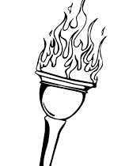
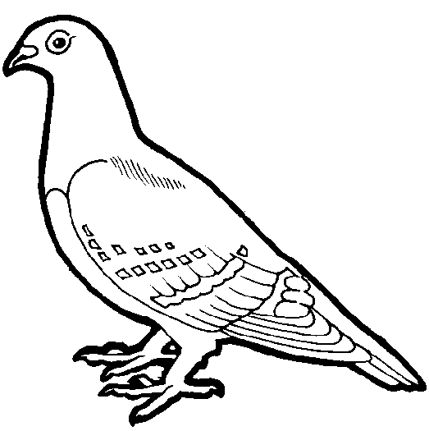
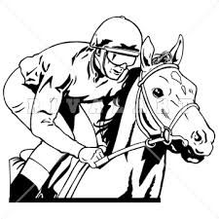
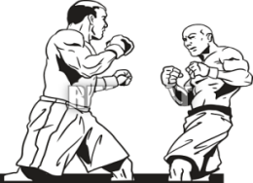
Second Grade Test (2)
A-Vocabulary
1-Complete the sentences with the correct words:
1- The ……………………………..of exchanging rings during a wedding ceremony dates back to ancient times.
2-The board game chess ………………………………..in India in the 6th century.
3- Don knows , when surfing, that he could drown or get attacked by sharks, but he's not scared. He has a lot of ………………….
4-Thousands of runners participate in the ……………………………………….every year.
up for
marathon
originated
guts
practice
2-Write the correct word under its picture:
……….….
……….….
……….….
……….….
3- Match the sport with its picture:
Boxing/Wrestling/Ice Hockey/Equestrian
……….….
……….….
……….….
……….….
4-Write 2 facts about the Olympic Games
1-………………………………..………………………………………………………
2-………………………………...………………………………………………………
B-Grammar
1-Rewrite a sentence with a gerund or gerund phrase:
a-It is difficult, but thrilling, to learn how to ski.
………………………………………………………………………………………………………………………………
b-It is exciting to attend a live sporting event.
……………………………………………………………………………………………………………………………..
2- Complete the sentences with a gerund or gerund phrase:
a- ……………………………….is a good idea.
b-………………………………..is a bit boring.
c-………………………………..gives me energy.

