Slide 1
Kingdom of Saudi Arabia
Ministry of Education
The 64th Secondary School
English Final Exam
Time: 3 hours
Pages:3
اختبار مادة اللغة الانجليزية للصف الثاني الثانوي
الفصل الدراسي الثاني لعام 1435\1436 هـ
اسم الطالبة:..................................................................................
رقم الجلوس:.................................................................................
اليوم:...............................التاريخ: .......\ 8 \ 1436هـ
رقم السؤال | الدرجة رقما | الدرجة كتابة | اسم المصححة وتوقيعها | اسم المراجعة وتوقيعها | اسم المدققة وتوقيعها
الأول
الثاني
الثالث
الرابع
المجموع رقما كتابة …………………………………………………..
درجة التقويم
الدرجة الكلية
24
30
6
جمعته: .......................................التوقيع.....................................
راجعته:.......................................التوقيع......................................
عضوة الكنترول:.............................التوقيع.....................................
Ready for the exam?! Be confident and start

Slide 2
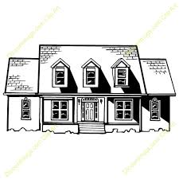
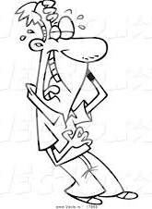
الصف: الثاني الثانوي
المادة: اللغة الإنجليزية
الزمن: 3 ساعات
الممـــلكة العــربية الســعودية
وزارة التــــربيــة والتعلـــــيم
الـثانوية الرابــعة والســـــتون
اختبار الفصل الدراسي الثاني لعــــام 1435-1436 هـ
1-Composition
A- Write 2 sentences about each picture:
6
1…………………………………….………………….……………………………………
……………………………………………………………………………………………….
2…………………………………………..…………………………………………………
………………………………….………………………….……………………………..…
Ha Ha
Ha
1…………………………………….………………………………………………………
………………………………………………………………………………………………
2…………………………………………..…………………………..……………………
………………………………….………………………………………………………..…
B-Write a paragraph of 8 lines in which you talk about how to live (A Healthy Life). The ideas in the box may help you.
…………………………………………….
…………………………………….……………………………………………………………………………………………………………………………………………………………………………………………………………………………………………………………………………………………………………………………………………………………………………………………………………………………………………………………………………………………………………………………………………………………………
………………………………………………………………………….…………………………………………………………..……………………………………………………………………………………………………………………………………………………………………….……………………………………………..…………………………………………………………………………………………………………………….…………………..…………………………………………………………………………………………………………………………………………………………………………………………………………………………………………………………………………………………..……
………………………………………………………………………………………………..
Ideas to help me:
*sweet life
*enjoy it
*stay healthy
* sleep
*healthy food
*examples
*avoid junk food
*examples
*avoid/stop smoking
*daily exercises like..
*lots of water
*live healthy & happily

Slide 3
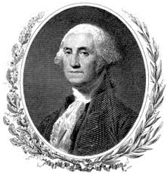
2-Comprehension
6
Read the following passage then answer the questions below:
The White House is the official residence and main workplace of the President of the United States. It is in Washington, D.C. and was built between 1792 and 1800.The White House has four stories , the Ground Floor, State Floor, Second Floor and Third Floor plus a two-story basement. Today, the White House Complex includes the Executive Residence where the president and his family live. Also, there is the West Wing which is the location of the Oval Office.
There are many famous rooms in the White House. The Entrance Halls is the primary and formal entrance. There are three state parlors on the State Floor of the White House: The Green Room, The Blue Room and the Red Room. They are all decorated in shades of their respective colors and have been used for small receptions and tea.
The East Room is the largest room in the White House . It is used for entertaining, press conferences, ceremonies and occasionally for a large dinner. The White House’s oldest possession, a portrait of George Washington that was painted in 1797, hangs in the East Room next to
a portrait of his wife, Martha Washington, which was painted in 1878.
The State Dining Room is the larger of two dining rooms on the State Floor of the White House. It has 140 seats. The family Dining Room is also located on the State Floor. The room is used for smaller, more private meals. Today, the president uses the Family Dining Room more for working lunches and small dinners.
1-Answer correctly & shortly from the passage:
a-Where is the White House?.........................................................
b-How many stories are there? ……………………………………….…………
c- Who live in the Executive Residence?......................................
d-What is the largest room in the White House?..........................
e-What two colors are there in the passage?.............................
2-Mark (T) for true sentences and (F) for false ones:
a-( ) The Oval Office is in the West Wing.
b-( ) The portraits of George Washington and his wife, Martha, were painted in the same year.
c-( ) The State Dining Room can have 140 people.
d-( ) Conferences and ceremonies are held in Dining Room.
3- Give a suitable title for the text.
………………………………………………………………….
4-Write the correct word under its picture::
*a portrait
*a seat
* an oval shape
1-…………..
2-…………..
3-Grammar
A-Choose the correct words :
a- There are (new, enormous / enormous, new / new & enormous) windows.
b- (The hard / The harder / The hardest) test I have taken was in chemistry class.
c-People who talk about themselves all the time are (irritate / irritating / irritated ).
d- They act as if they (are /were / have been) kings.
6

Slide 4
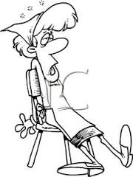
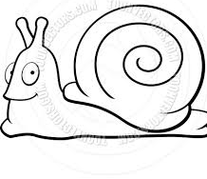
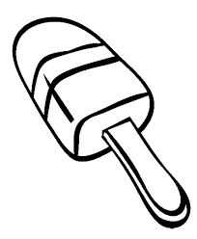
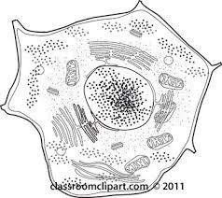
B-Do as shown between brackets:
1- I am not rich to buy that house. (Insert (enough) into the correct place)
………………………………………………………………………….
2-………………………………………is a bit boring.
( Complete with a gerund or gerund phrase)
3-What will happen if you don’t do your homework.
(Complete the sentence with get + adjective/past participle)
………………………………………………………………………………………………………………………….
4- Write a sentence about the following picture, using a suitable phrasal verb:
………………………………………………………………………………………………………
5- People should not feed wild animals. (Change into passive)
……………………………………………………………………………………………………………………………………..
6- If money grew on trees, …………………………………………………………………………………………
(Complete the sentence correctly)
4-Vocabulary
1-Write the words under the correct pictures:
snail - torch- popsicle- skates- cell
6
………………
………………
………………
………………
2-Choose the suitable words to complete the sentences:
a- The museum had a quiet & peaceful ……………………..……..
b- The board chess game ……………………..……..in India in the 16th century.
c- Asma’s teacher said her paper was …………………………She gave her A.
d- My sister had to have surgery last week. Even though the……………………………..of the surgery was only 20 minutes, it seemed like a really long time.
3-Match correctly
duration-atmosphere-- remarkable –poverty-originated
1-maintain 2-vanish 3-fragrant smell 4-bond | A
( ) aroma ( )connection between living things. ( ) keep in a good condition ( )disappear | B
Good Luck,,,

