Slide 1
Laugh Out Loud

Slide 2
Introduction
What TV show or comedian makes you laugh the most? Why?
What is the funniest joke you know?
What does the word “joke “mean?

Slide 3
Watch this clip then…
What do you think makes a joke funny?
If someone has to explain a joke to you is it still funny ? Why ? Why not?

Slide 4
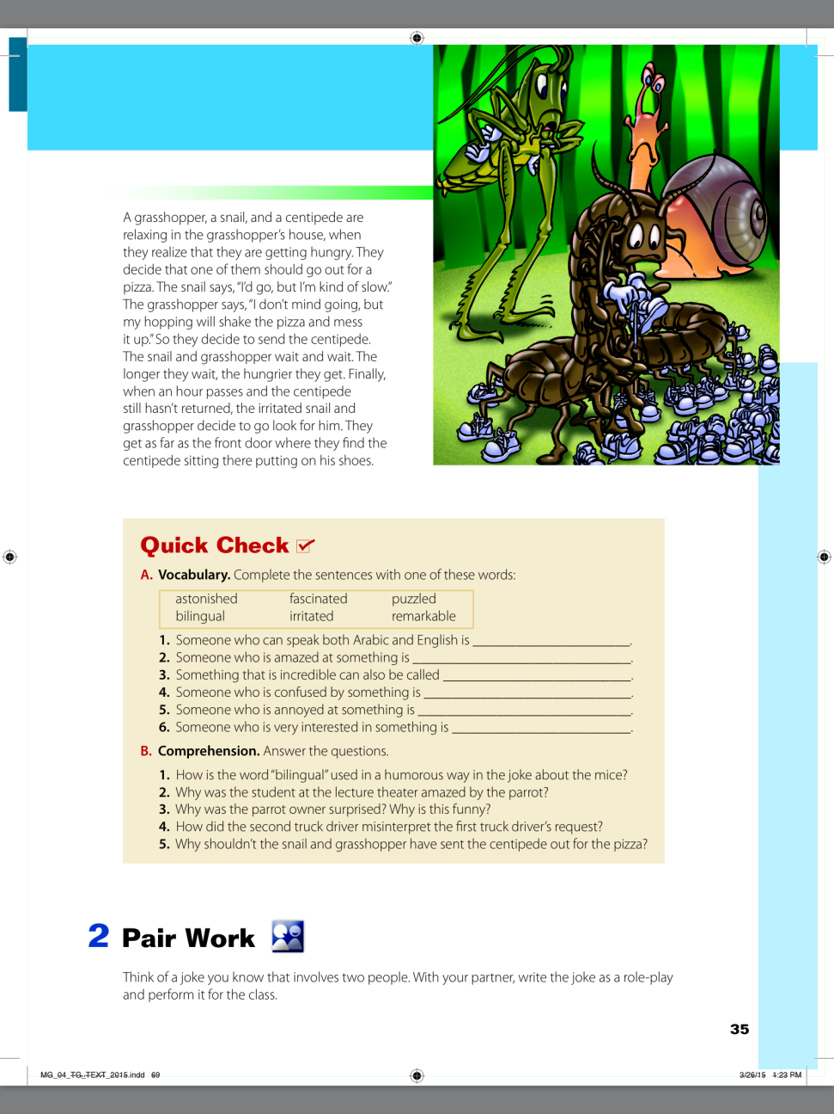
Open your book page 34, 35

Slide 5
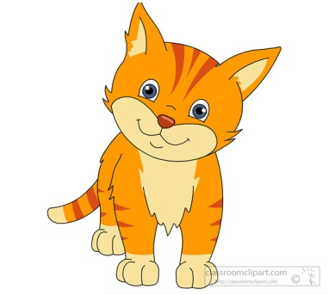
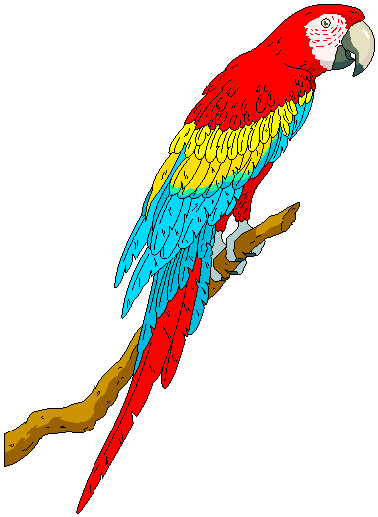
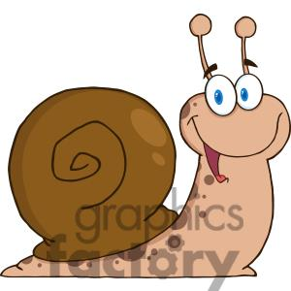
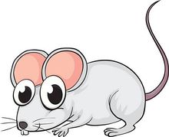
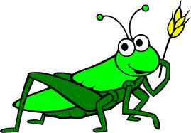
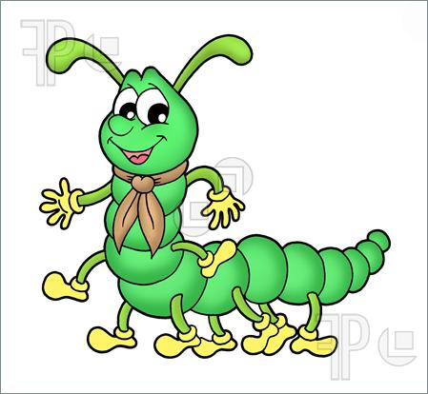
Discussion
What animals are the jokes about?
Match
Grasshopper – centipede – mouse- cat- penguins – snail - parrot

Slide 6
Listen to the jokes then answer the question
What does the word “bilingual” mean?

Slide 7
Listen to the jokes then answer the question
Does the parrot like the class?
What is the meaning of :
astonished - remarkable -fascinated

Slide 8
Listen to the jokes then answer the question
Did you understand this joke?
“puzzled” means …………………..

Slide 9
Listen to the jokes then answer the question
Have you heard this joke before?
“irritated” means …………………..

Slide 10
Let’s do exercise A page 35

Slide 11
Home work
Work book page 21

